Slide 1

Real Estate Price Forecasting
DATA 606 – Capstone in Data Science
Sai Teja Gunamoni (YG69535)

Slide 2
Agenda:
Introduction
Data Exploration
Exploratory Data Analysis
Feature Analysis
Outlier Analysis
Correlation Analysis
Machine Learning Models
Model Performance
Conclusion

Slide 3
Introduction:
A house's price can occasionally be estimated based on a number of factors, and it can be challenging to dynamically identify and monitor each one. Therefore, determining a home's price through a variety of statistical and machine learning techniques can use all underlying patterns and be dynamically active to understand the factors influencing a home's price.
Motivation:
- Traditional methods rely on comparing similar properties in the neighborhood.
- Machine learning can identify underlying patterns and consider various aspects for a more accurate prediction.
Analyzing statistical and exploratory data is crucial to examining these aspects. We need to conduct thorough data analysis before drawing any conclusions about the behavior of the data. Machine learning regression analysis will then be used to solve the problem.

Slide 4
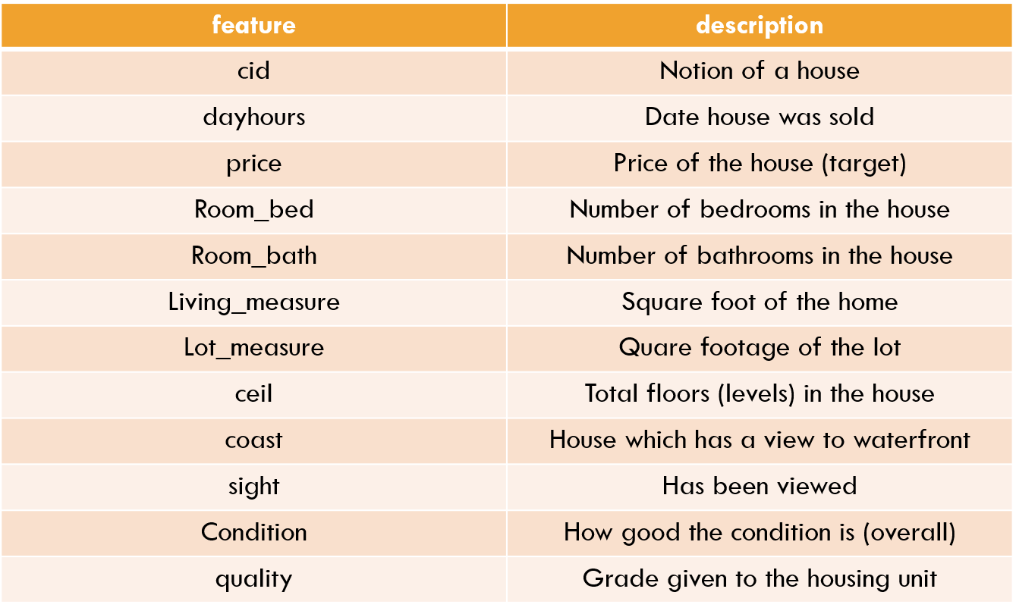
Data Exploration:
The dataset was obtained from Kaggle.
This relational dataset contains a number of Input Features about the house including its size, year of construction, years of renovation, condition, number of rooms, and so forth.
In addition to 22 input features and 1 (price) output feature.
The price of the house is the output feature (Target Variable).

Slide 5
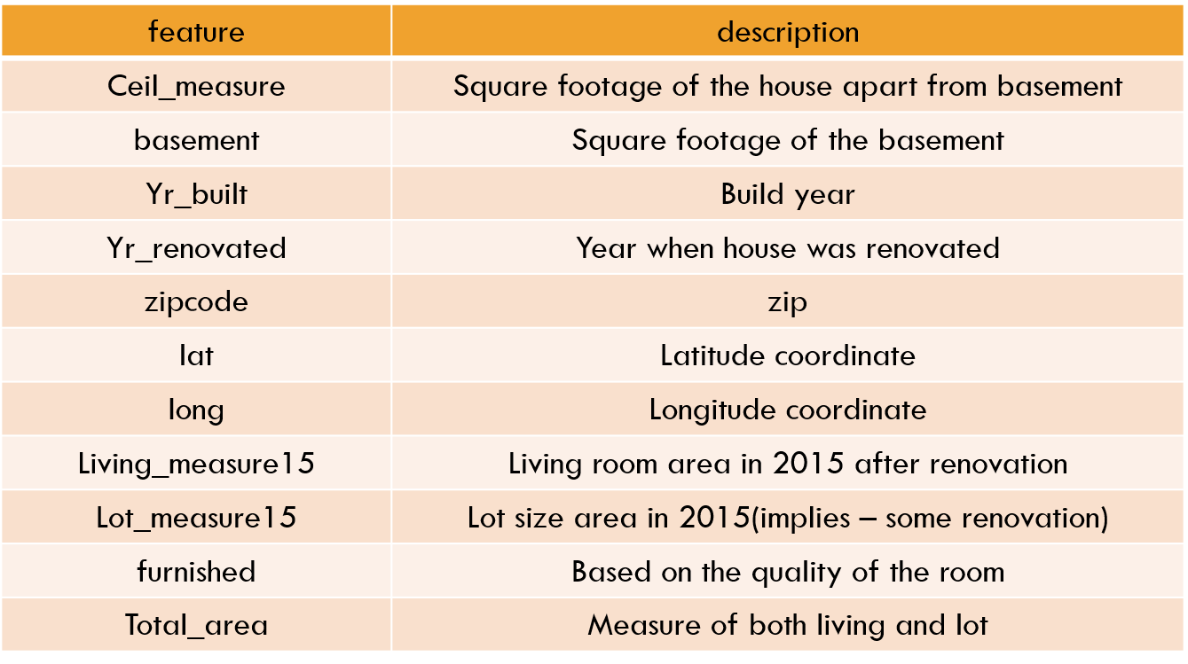
Data Exploration:
The dataset includes 21,613 house price details in total.
The price range of the house is 75000 to 7700000.
Duplicate and null value checks
No missing values exceeding 5% in any feature.
Machine learning algorithms with explainability are the best approach for this type of data.

Slide 6
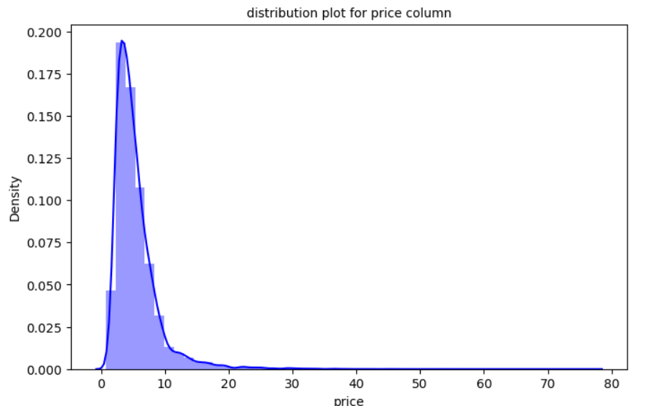
Exploratory Data Analysis:
Price Distribution: The price column is skewed to the right, indicating more data points concentrated in the lower range.
Skewness: 4.0217
Kurtosis: 34.5224

Slide 7
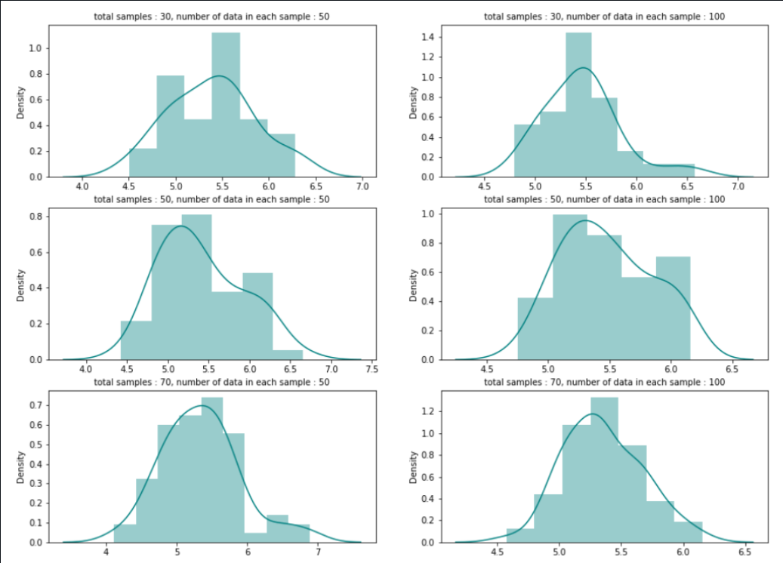
Exploratory Data Analysis:
Central Limit Theorem (CLT): Although the sample size is large, the data doesn't strictly follow a normal distribution.

Slide 8
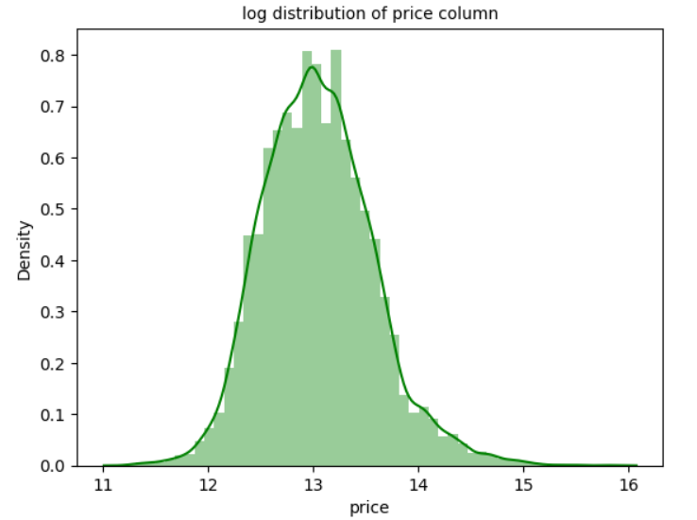
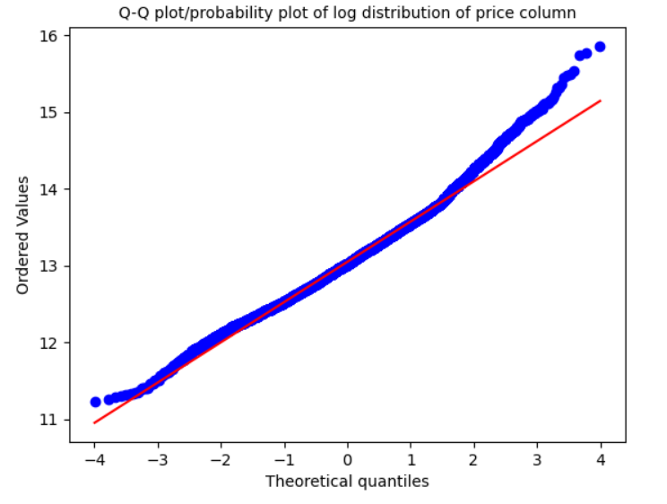
Exploratory Data Analysis:
Log Transformation: Log transformation was attempted on the price column to achieve normality, but the results weren't perfect.
Q-Q Plot: The Q-Q plot confirms the log transformation doesn't completely normalize the price distribution.

Slide 9
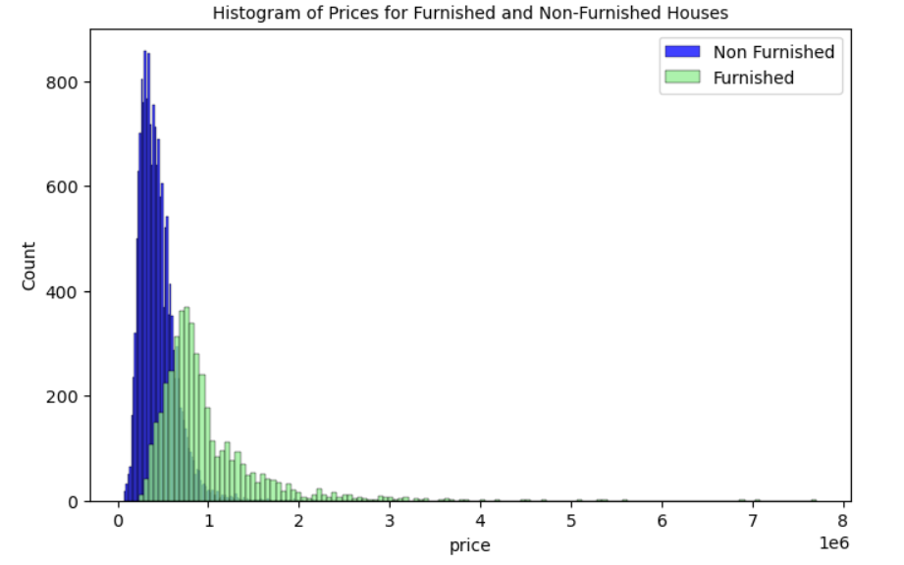
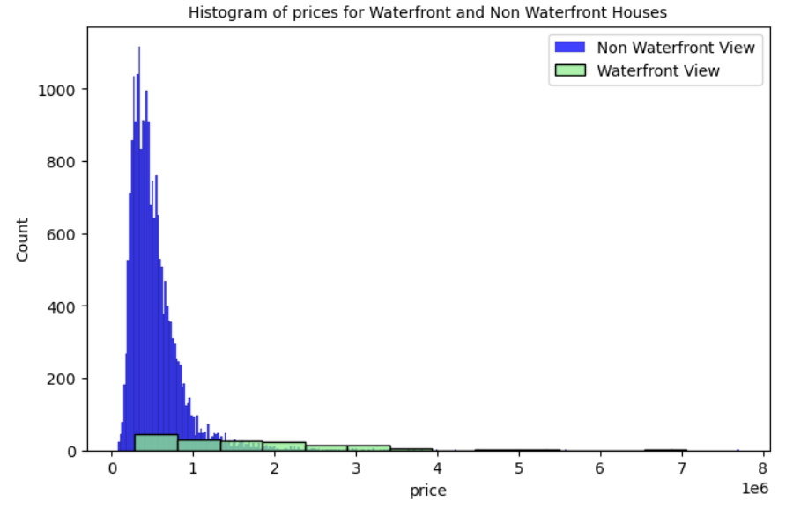
Feature Analysis:
Univariate, Bivariate, and Multivariate Analysis for the Key features of House like: Furnished, Waterfront view, House quality
Furnished: Houses with furniture tend to be more expensive (Univariate analysis).
Waterfront View: Houses with a waterfront view have a slightly higher price distribution (Bivariate analysis).

Slide 10
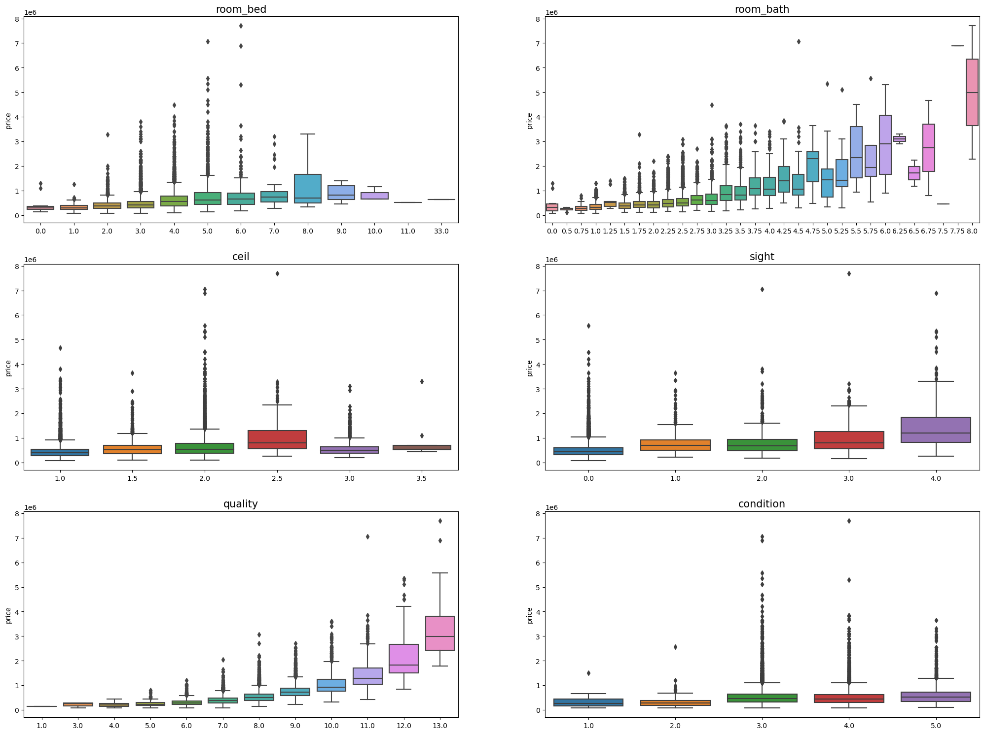
Feature Analysis:
Categorical Data: Features like overall quality and number of bathrooms show a positive correlation with Price (boxplots).

Slide 11
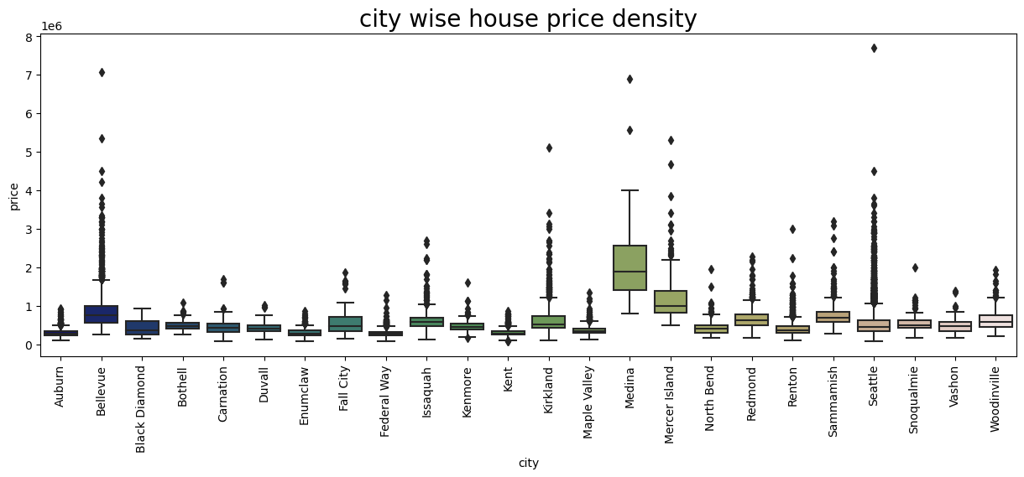
Feature Analysis:
Zip Codes: Most data originates from Seattle, with Medina having the highest average price (potentially due to luxury houses).

Slide 12
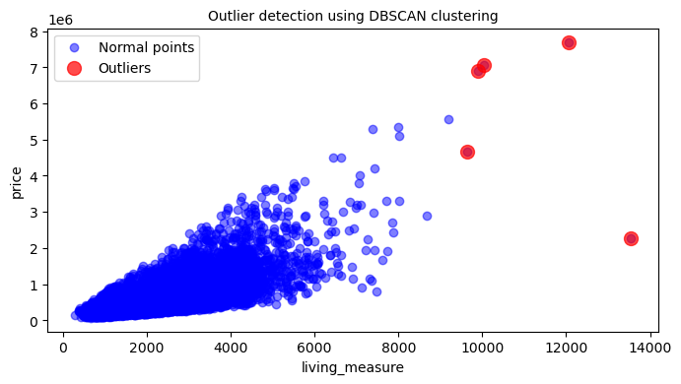
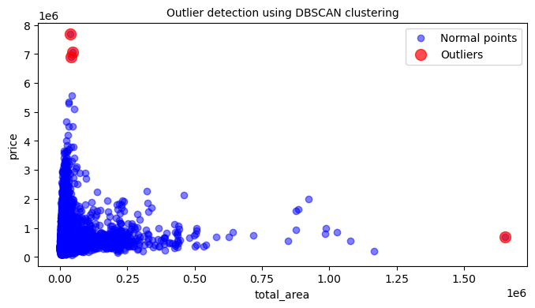
Outlier Analysis:
Outliers were identified in features like living area and total area using boxplots and DBSCAN clustering.
Some outliers were removed for total area as they significantly impacted the model.

Slide 13
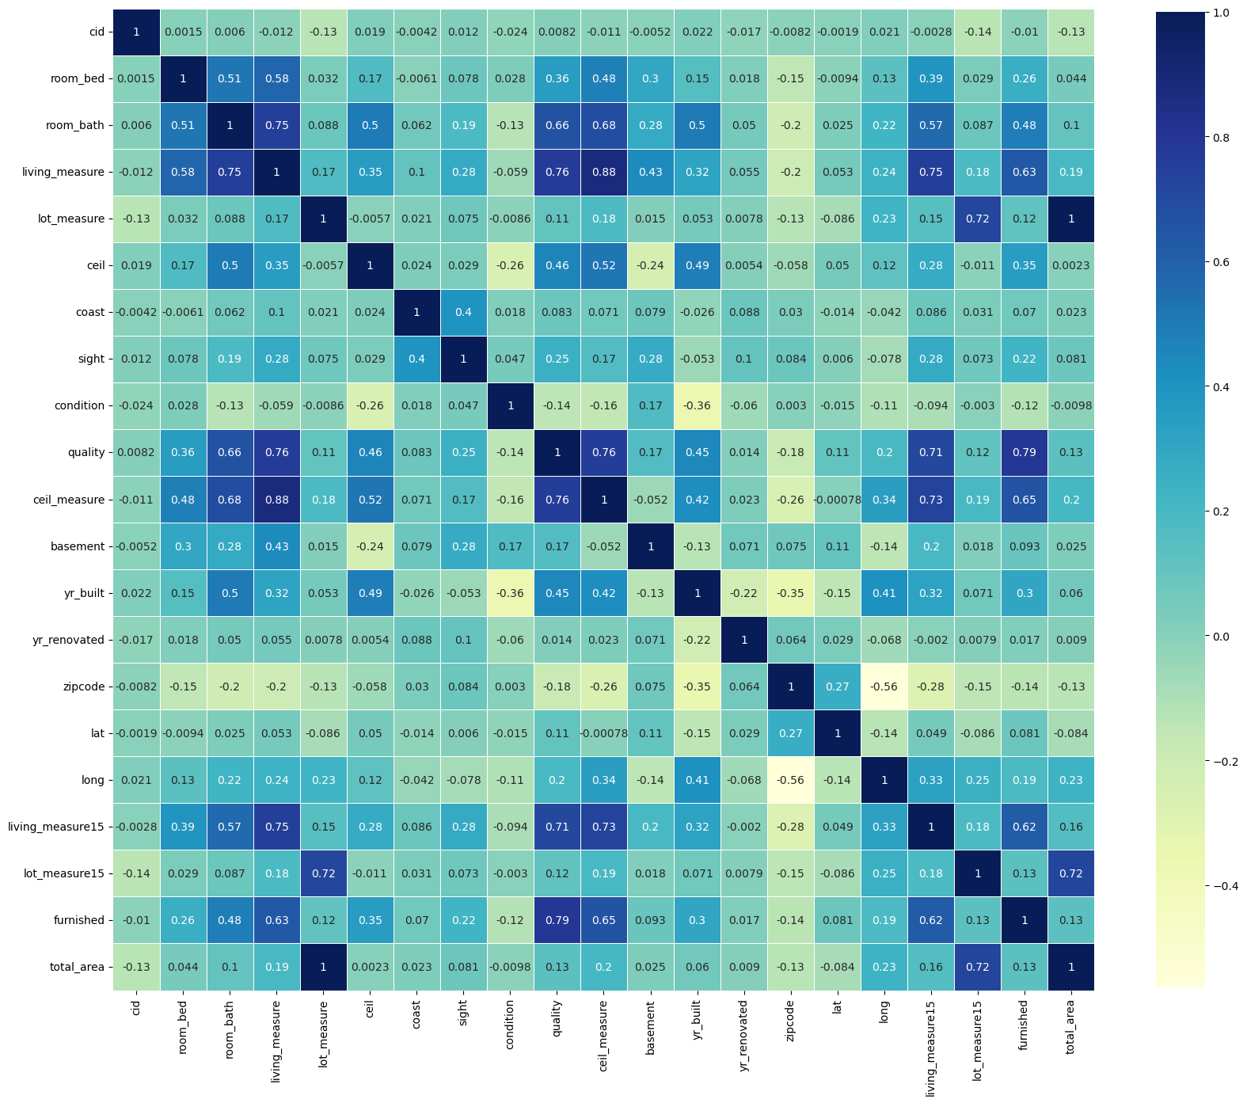
Correlation Analysis:
Features like living area, quality, ceiling measure, and furnished showed a positive correlation with price (heatmap).
Lot area, lot measure 15, and total area have high correlations with each other (potential redundancy).

Slide 14
Machine Learning Models:
Below selected models has been used for machine learning modelling for k-best features.
K-neighbor Regressor
Random Forest Regressor
Decision Tree
Lasso Regression
Ridge Regression
Light GBM
Light GBM achieved the best performance:
Mean Absolute Percentage Error (MAPE): 0.12 (train), 0.14 (test)
R-squared (R²) score: 0.93 (train), 0.87 (test)
Linear models (Lasso and Ridge) performed well but captured fewer complex patterns (lower R²).

Slide 15
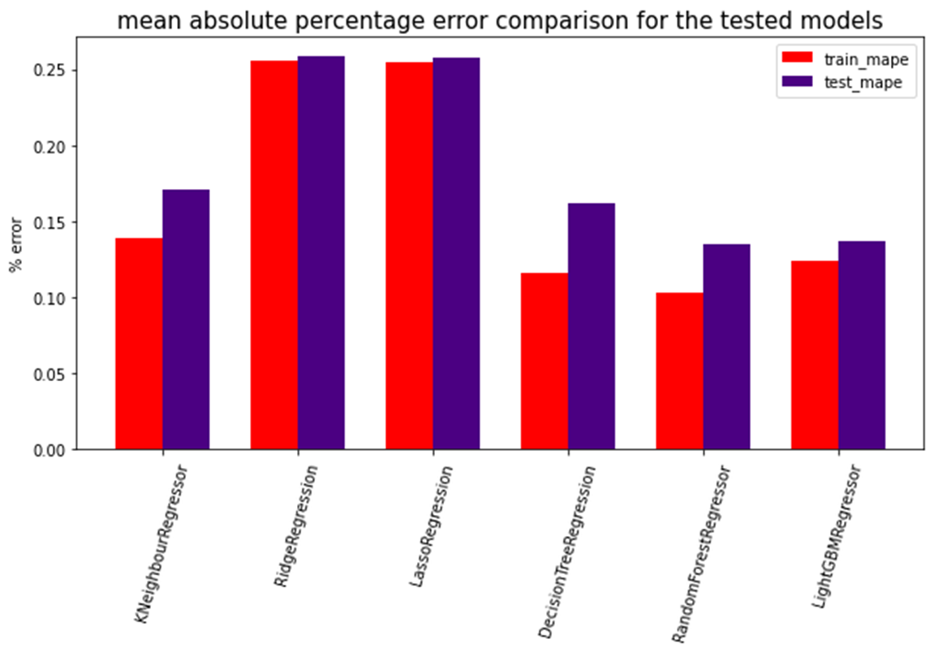
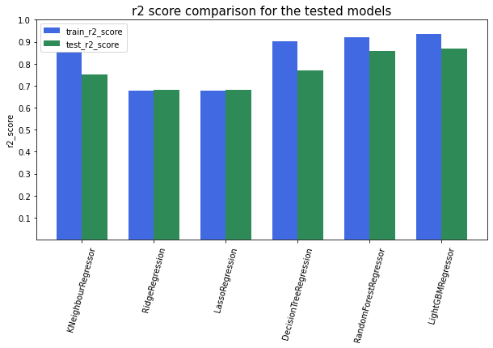
Model Performance:
Mean Absolute Percentage Error and R2 Scores for the all the tested models.

Slide 16
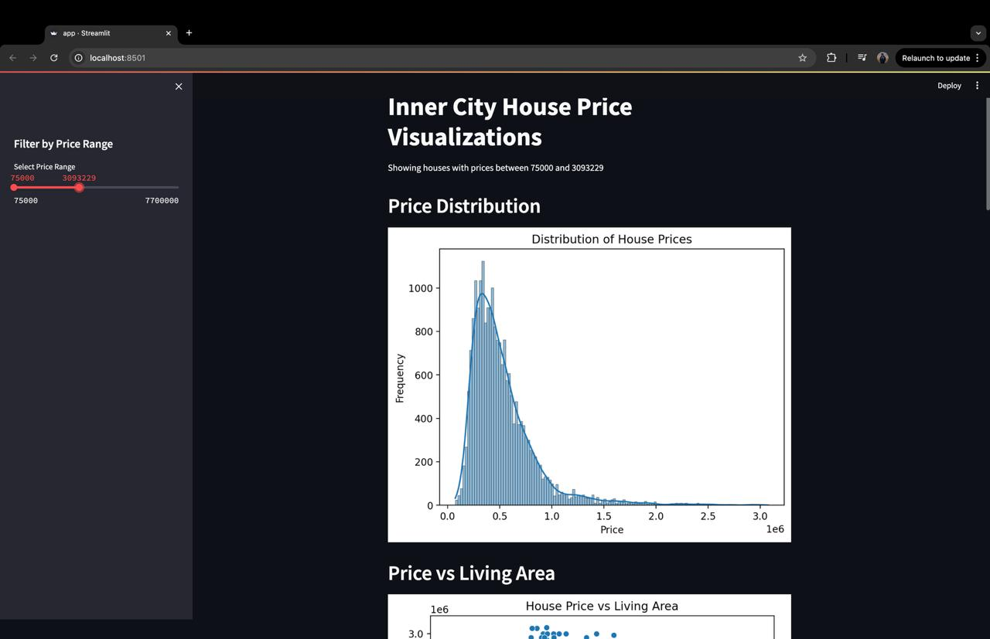
Web Application:
A user-friendly web application was built using Streamlit to make the model accessible and interactive. Key features include:
User Input: Fields for selecting particular crime types and also to choose specific date range.
Prediction Output: After processing the input data, the app displays the contours at the locations where the crime has been occured.

Slide 17
Conclusion:
Six models, including KNN, Lasso, Ridge, Decision Tree, Random Forest, and Light GBM, were trained; "Light GBM“ emerged as the most effective model for predicting house prices.
The model achieved high accuracy with a MAPE of 0.12-0.14 and R² of 0.93-0.87 for the test and train respectively.
Model can be useful for buyers, sellers, and loan providers in estimating house prices accurately.
Feature importance: living_measure, quality, and ceil_measure were among the most influential features
Feature selection techniques like "monotone" ensured relevant features were considered.
Although they do well, linear models like Lasso and Ridge are unable to identify patterns and produce lower r2 scores. Additionally, in comparison to other models, the percentage error is extremely high.

